Slide 1
Analyzing Social Media Addiction Among Students
Data Visualization Project
Presented by: Manahil Zahra

Slide 2
Table of Content
Introduction
Dataset Information
Analysis Goals
Data Visualization
Recommendations
Conclusion

Slide 3
Introduction:
This analysis explores social media usage pattern among students , aiming to identify addiction levels ,most used platforms and impact on academic performance.
The goal is to explore the level of social media addiction and its consequences .

Slide 4
Dataset Information
Source:
Kaggle Dataset
Dataset Name:
Students Social Media Addiction
Number of students surveyed:
700 + Students
Key Column:
Student-Id
Academic_Level
Avg_Daily_Usage_Hours
Most_Used_Platform
Affects_Academic_Performance
Sleep_Hours_Per_Night
Mental_Health_Score

Slide 5
Analysis Goals
Analysis Objectives:
What is the overall distribution of Social media addiction scores among students?
Which platforms are most popular among students?
Do addiction score different between male and female students?
Is there a relationship between time spent on social media and sleep duration?
Which numeric variables are strongly correlated with social media addicted score?

Slide 6
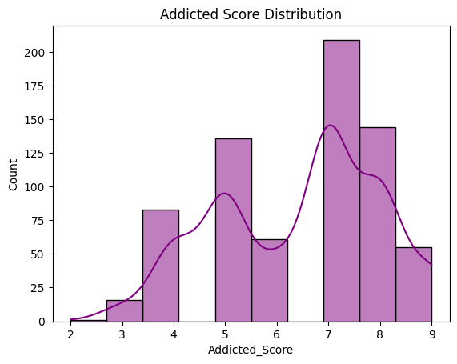
Addicted Score Distribution
Key Insight :
Distribution of Addicted Scores (Histogram):
Most students have an addiction score between 5 and 9, with very few scoring below 3 .A majority of students demonstrate moderate to high levels of social media addiction.

Slide 7
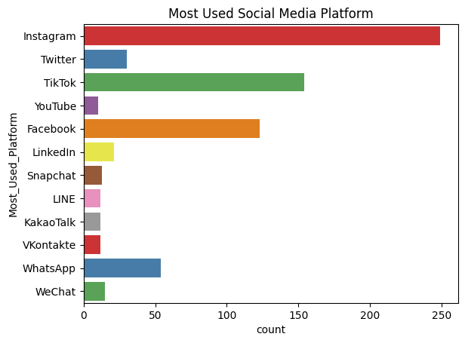
Most Used Social Media Platform
Key Insight :
Bar chart shows that Instagram and TikTok are the most popular platforms among students.

Slide 8
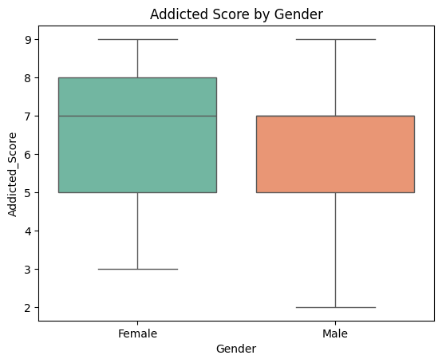
Addicted Score by Gender
Median addicted score is slightly higher in females than males ,so Social Media addiction is more intense among female student.
Both genders show a wide range of scores and contain outliers .
Key Insight:

Slide 9
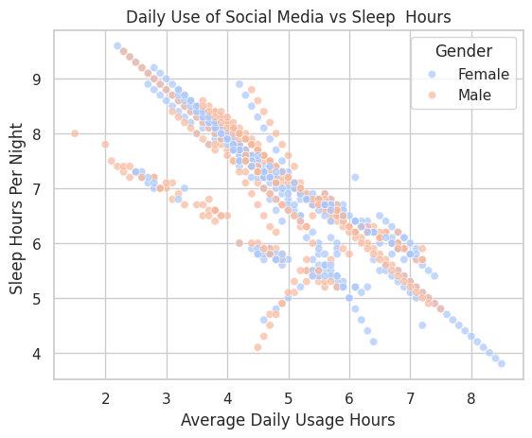
Average Daily Usage vs Sleep Hours(Scatter Plot)
The scatter plot shows a slight downward trend , suggesting that as average daily social medial platform increases , sleep hours tend to decrease.
Females show more data points with higher daily usage and slightly reduced sleep compared to males
This trend appears across both males and females .
Key Insight:

Slide 10
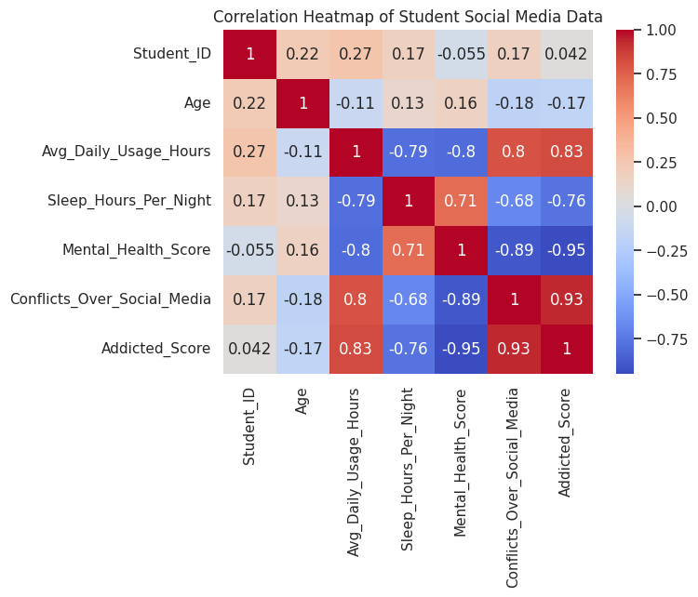
Correlation Heatmap of Student Social Media Data
Addicted_Score has a strong positive correlation with:
Addicted_Score has a strong negative correlation with:
Sleep Hours
Mental Health Score
Avg Daily Usage Hours
Conflict Over Social Media

Slide 11
RECOMMENDATION
Encourage digital well-being habits.
Students can benefit from time management apps to reduce screen time.
Conduct workshops on time management.
Raise Awareness about social media addiction seen among students.

Slide 12
Conclusion
Students with high social media usage tend to have lower academic performance and reduced sleep.
Instagram and TikTok are widely used among students.
Heavy social media users have less sleep.

Slide 13
THANK YOU!

